Slide 1

Marketing Metrics
Analytics Avengers
Ting-Yu Chen, Kexin Hu, Jnana Kundur Prakash, Xinxin Yang

Slide 2


Category P Overall Objective
Benchmark against key competitors to understand their strengths, weaknesses
Strengthen our market leadership
Enhance areas of vulnerability while proactively mitigating potential risks
Page 2

Slide 3

Level-1 Dashboard Design
Metrics of Choice
1. Sales & Growth rate
5. ROS
Audience
CXO Level
2. Market Share
6. Profit Per Order
Purposes & Goals
Overall category and market performance Growth trajectory
General trend Competitive landscape
Identify complications based on the current situation
3.Relative Market Share
7. Profit Per Customer
4.Profit
8. Price
Update Frequency
Yearly
Page 3

Slide 4
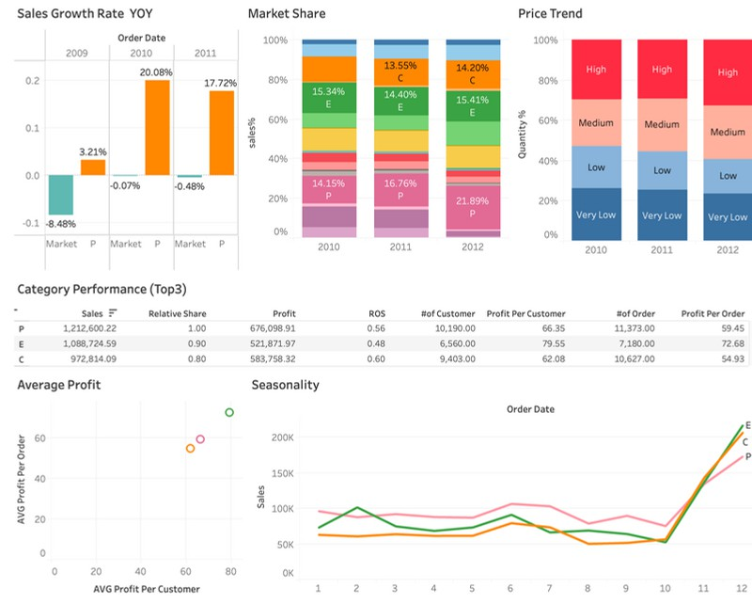
Level-1 Dashboard
Time Frame: Recent 3 years
Page 4

Slide 5
L1
Insights
Actions
Market leader position
Growth potential in profitability
Opportunity in Q4 Premiumization trend
Review Pricing Strategy
Focus on Cost Optimization Improve Operational Efficiency Set Profitability Targets
Page 5

Slide 6


Drawbacks & Tradeoffs
L1
项目1
100%
- By focusing on the competitors, we might be at risk of losing information
of dynamics changes in other categories .
项目5 20%
项目1 20%
项目2
85%
项目3
47%
项目4
25%
项目4 20%
项目2 20%
项目5
15%
项目6
8%
项目3
-Lack of granularity
20%
-. Neglect other costs
in the profit metrics.
-Unable to know the detailed informations
Page 6

Slide 7
Level-2 Dashboard Design
Metrics of Choice
Audience
Managers of different function & KPI Stakeholders
Purpose & Goal
Dive into metrics in L1 Dashboard
Help category maintain leading position in sales and potentially increase profitability Develop actionable strategy to improve overall performance for different functional teams, ex: logistic team, product development team, marketing team
Cover metrics for 4P (Product, Price, Place, Promotion) and 4C (Customer, Cost, Communication, Channel)
Update Frequency
Yearly
Product Variety
Top 10 Popular Products
Popular Product by Time
Price Level by Category
Average Delivery Time
RFM Customer by Category
RFM Customer by Channel
Page 7

Slide 8
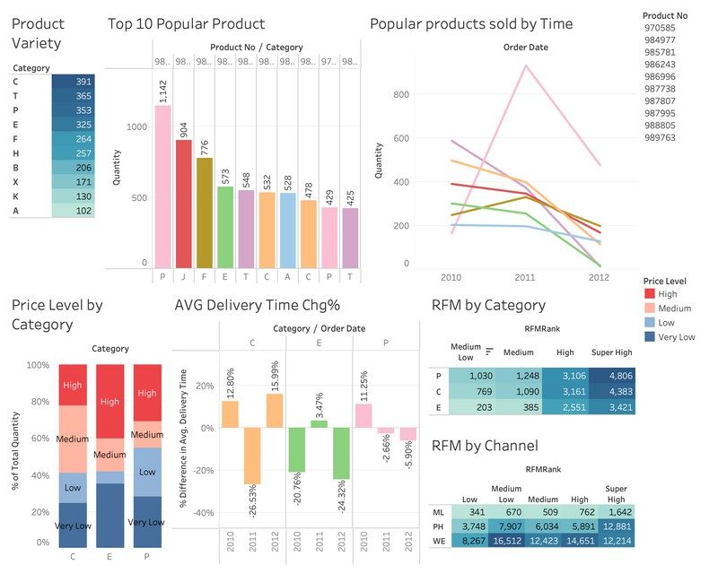
Level-2 Dashboard
Page 8

Slide 9
L2
Insights
Actions
High Product Variation
Dominance of Specific Products
Pricing Impact on Sales Logistics Performance Correlates
with Sales Peaks
Optimize Product Portfolio
Promote High-Performing Products
Refine Pricing Model
Enhance Delivery Strategies
Page 9

Slide 10


L2
Drawbacks & Tradeoffs
Data Overload
Risk of Short-Term Focus
Complexity in Implementation
Page 10

